Slide 1
Software Engineering (SDLC – Process Models) _____________________________________________________
Feb 2013

Slide 2
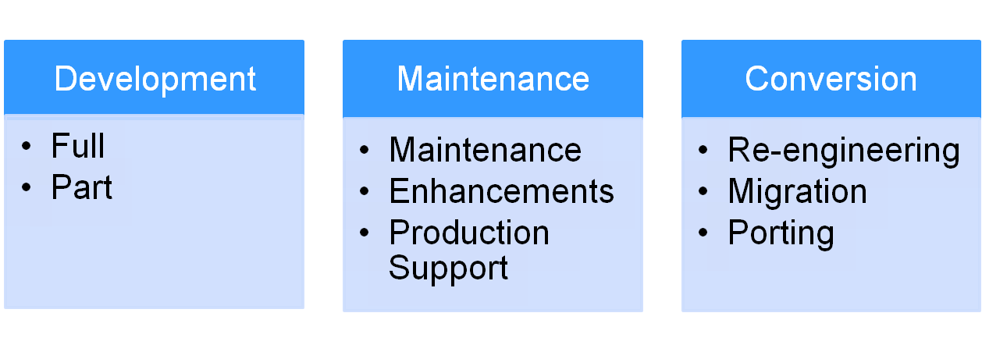
Types of Software Projects
Full Development - From requirement analysis to post project implementation and warranty
Part Development – Partial Development
Regular Maintenance - Revision or enhancement or modification
Re-engineering - Down-sizing or up-sizing
Migration - involves moving an existing application from one platform to another
Porting - Making existing source code available on more than one platform.
Notes:
Life Cycle: The period of time that begins with the decision to develop a software product and ends when a software product is delivered. – IEEE
There are other lifecycles as well – like testing, certifications, customizations, implementation

Slide 3
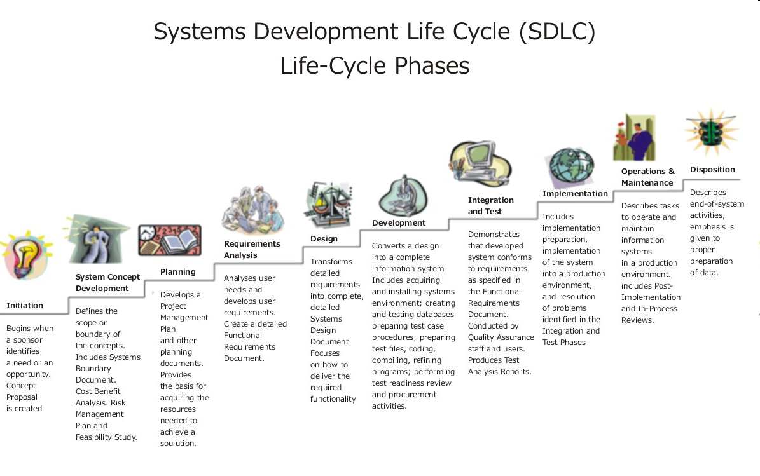
SDLC
Notes:
The SDLC is defined as a combination of Gates, Roles and Responsibilities. SDLC activities are further subdivided into processes defined as groups of related activities.
Gate - A decision or transition point for project.
Role - An individual or group participating in the project
Responsibility - An objective (action, document, or other deliverable) for which a role is assigned ownership.
Process/Procedure - One or more activities focused on a particular role and its responsibilities for a project.
A process may include the activities performed by several individuals assigned to one or more roles. However, the primary focus of any process is typically a single role and its responsibilities over the entire project. Each Standard Operating Procedure (SOP) document corresponds to an individual process in the SDLC.

Slide 4
Process Models
Waterfall
Incremental
RAD
V Shaped
Prototyping
Spiral
Agile SDLC
  Adaptive S/W Dev (ASD), Feature Driven (FDA), Extreme Prog., Rational Unify Process (RUP), Dynamic S/W Dev Method (DSDM)
A framework that describes the activities performed at each stage of a software development project
Prescriptive
Evolutionary
Notes:
> Unified Process is a combination of characteristics of conventional process models, implemented in an agile way
> Waterfall, Incremental and RAD are referred as “Prescriptive process models”, Prototyping, Spiral are known as “Evolutionary Process Models”
> Software process model (SPM) usually includes – Tasks / Artifacts (data, files, etc.) / Actor / Decisions

Slide 5
Waterfall Model (Linear Sequential)
Contract Review, Project Setup, Team formation, Training
Defines needed information, function, behavior, performance and interfaces
Data structures, software architecture, interface representations, algorithmic details
Code Construction
Integration Test, And UAT
Implementation, User training
P
R
O
J
E
C
T
P
L
A
N
N
I
N
G
&
M
O
N
I
T
O
R
I
N
G
Project
Initiation
Q
U
A
L
I
T
Y
A
S
S
U
R
A
N
C
E
Requirement
Design
Coding
Testing
Deploy
Notes:
Is also called Linear Sequential model. By Royce in 1970

Slide 6
Waterfall Model…..
Strengths
  Easy to understand, easy to use
  Provides structure to inexperienced staff
  Milestones are well understood
  Sets requirements stability
  Good for management control (plan, staff, track)
  Works well when quality is more important than cost or schedule
Weaknesses
  All requirements must be known upfront
  Inhibits flexibility: Deliverables are considered frozen
  Can give a false impression of progress
  Does not reflect problem-solving nature of software development – iterations of phases
  Integration is one big bang at the end
  Little opportunity for customer to preview the system (until it may be too late)

Slide 7
Waterfall Model…..
When to Use?
  Requirements are very well known
  Product definition is stable
  Technology is understood
  New version of an existing product
  Porting an existing product to a new platform
  Quality is more important than cost & schedule

Slide 8
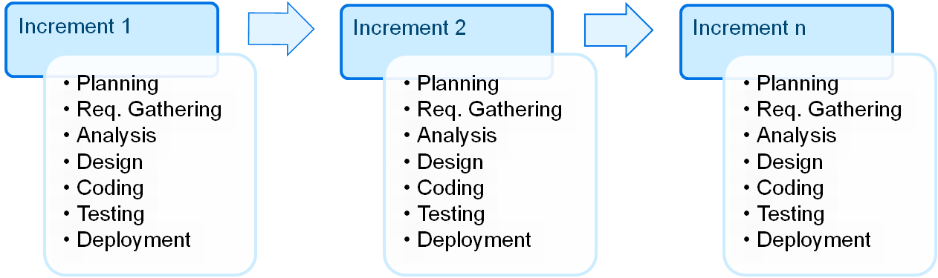
Incremental Model
Construct a partial implementation of a total system
Then slowly add increased functionality
The incremental model prioritizes requirements of the system and then implements them in groups.
Each subsequent release of the system adds function to the previous release, until all designed functionality has been implemented.
First increment is usually a core product which is built on top of, in the next increments - Each increment results in a finished product.
Notes:
D L Parnas proposed this model. To design & Deliver a minimal subset (still a useful system) of the whole system

Slide 9
Incremental Model…..
Strengths
  Develop high-risk or major functions first
  Each release delivers an operational product
  Customer can respond to each build
  Uses “divide and conquer” breakdown of tasks
  Lowers initial delivery cost
  Initial product delivery is faster
  Customers get important functionality early
  Risk of changing requirements is reduced
Weaknesses
  Requires good planning and design
  Requires early definition of a complete and fully functional system to allow for the definition of increments
  Well-defined module interfaces are required (some will be developed long before others)
  Total cost of the complete system is not lower

Slide 10
Incremental Model…..
When to Use?
  Risk, funding, schedule, program complexity, or need for early realization of benefits.
  Most of the requirements are known up-front but are expected to evolve over time
  A need to get basic functionality to the market early
  On projects which have lengthy development schedules
  On a project with new technology

Slide 11
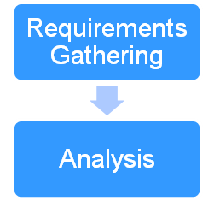
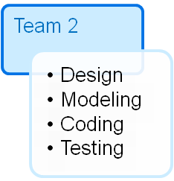
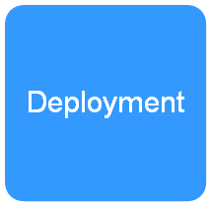
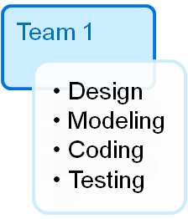
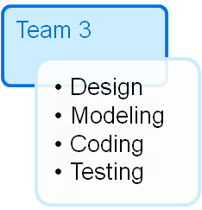
Rapid Application Development
Requirements planning phase (Discussion of business problems)
User description phase – automated tools capture information from users
Construction phase – productivity tools, such as code generators, screen generators, etc.)
Cutover phase -- installation of the system, user acceptance testing and user training

Slide 12
Rapid Application Development…..
Strengths
  Reduced cycle time and improved productivity with fewer people means lower costs
  Time-box approach mitigates cost and schedule risk
  Customer involved throughout the complete cycle minimizes risk of not achieving customer satisfaction and business needs
  Focus moves from documentation to code (WYSIWYG).
  Uses modeling concepts to capture information about business, data, and processes
Weaknesses
  Accelerated development process must give quick responses
  Risk of never achieving closure
  Hard to use with legacy systems
  Requires a system that can be modularized
  Developers and customers must be committed to rapid-fire activities in an abbreviated time frame.

Slide 13
Rapid Application Development…..
When to Use?
  Reasonably well-known requirements
  User involved throughout the life cycle
  Project can be time-boxed
  Functionality delivered in increments
  High performance not required
  Low technical risks
  System can be modularized

Slide 14
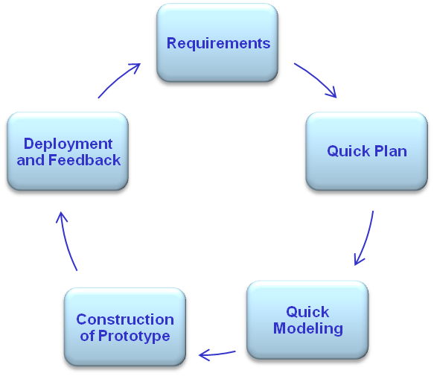
Prototyping Model
Developers build a prototype during the requirements phase
Prototype is evaluated by end users
Users give corrective feedback
Developers further refine the prototype
When the user is satisfied, the prototype code is brought up to the standards needed for a final product
Notes:
This builds the throwaway version (prototype) intend to test concept & requirements. Used to demo the “would be” system’s behavior

Slide 15
Prototyping Model…..
Strengths
  Customers can “see” the system requirements as they are being gathered
  Developers learn from customers
  A more accurate end product
  Unexpected requirements accommodated
  Allows for flexible design and development
  Steady, visible signs of progress produced
  Interaction with the prototype stimulates awareness of additional needed functionality
Weaknesses
  Tendency to abandon structured program development for “code-and-fix” development
  Bad reputation for “quick-and-dirty” methods
  Overall maintainability may be overlooked
  The customer may want the prototype delivered
  Process may continue forever (scope creep)

Slide 16
Prototyping Model…..
When to Use?
  Requirements are unstable or have to be clarified
  As the requirements clarification stage of a waterfall model
  Develop user interfaces
  Short-lived demonstrations
  New, original development
  With the analysis and design portions of object-oriented development.

Slide 17
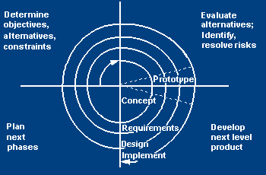
Spiral Model
Adds risk analysis, and 4gl RAD prototyping to the waterfall model
Each cycle involves the same sequence of steps as the waterfall process model
Introduced by B Boehm.
The model is spiral starts in middle & revisits the basic tasks
Notes:
Introduced by B Boehm. The model is spiral starts in middle & revisits the basic tasks (Requirement, Planning, Risk Analysis, Design, Construction and Implementation) continuously

Slide 18
Spiral Model…..
Quadrants of Spiral Model
Determine Objectives, Alternatives & Constraints
Objectives: functionality, performance, hardware/software interface, critical success factors, etc.
Alternatives: build, reuse, buy, sub-contract, etc.
Constraints: cost, schedule, interface, etc.
Evaluate Alternative Identify & Resolve Risk
Study alternatives relative to objectives and constraints
Identify risks (lack of experience, new technology, tight schedules, poor process, etc.
Resolve risks (evaluate if money could be lost by continuing system development
Develop Next Level Product
Create a design
Review design
Develop code
Inspect code
Test product
Plan Next Phase
Develop project plan
Develop configuration management plan
Develop a test plan
Develop an installation plan

Slide 19
Spiral Model…..
Strengths
  Provides early indication of insurmountable risks, without much cost
  Users see the system early because of rapid prototyping tools
  Critical high-risk functions are developed first
  The design does not have to be perfect
  Users can be closely tied to all lifecycle steps
  Early and frequent feedback from users
  Cumulative costs assessed frequently
Weaknesses
  Time spent for evaluating risks too large for small or low-risk projects
  Time spent planning, resetting objectives, doing risk analysis and prototyping may be excessive
  The model is complex
  Risk assessment expertise is required
  Spiral may continue indefinitely
  Developers must be reassigned during non-development phase activities
  May be hard to define objective, verifiable milestones that indicate readiness to proceed through the next iteration

Slide 20
Spiral Model…..
When to Use?
  When creation of a prototype is appropriate
  When costs and risk evaluation is important
  For medium to high-risk projects
  Long-term project commitment unwise because of potential changes to economic priorities
  Users are unsure of their needs
  Requirements are complex
  New product line
  Significant changes are expected (research and exploration)

Slide 21
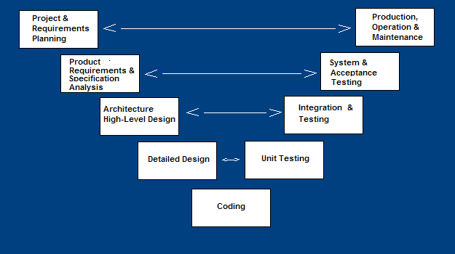
V Shaped Model
A variant of the Waterfall that emphasizes the verification and validation
Testing of the product is planned in parallel with a corresponding phase of development

Slide 22
V Shaped Model…..
Activities
  Project and Requirements Planning – allocate resources
  Product Requirements and Specification Analysis
  – complete specification of the software system
  Architecture or High-Level Design
  – defines how software functions fulfill the design
  Detailed Design
  – develop algorithms for each architectural component
  Production, operation and maintenance
  – provide for enhancement and corrections
  System and acceptance testing
  – check the entire software system in its environment
  Integration and Testing – check that modules interconnect correctly
  Unit testing
  – check that each module acts as expected
  Coding
  – transform algorithms into software

Slide 23
V Shaped Model…..
Strengths
  Emphasize planning for verification and validation of the product in early stages of product development
  Each deliverable must be testable
  Project management can track progress by milestones
  Easy to use
Weaknesses
  Does not easily handle concurrent events
  Does not handle iterations or phases
  Does not easily handle dynamic changes in requirements
  Does not contain risk analysis activities

Slide 24
V Shaped Model…..
When to Use?
  Excellent choice for systems requiring high reliability – hospital patient control applications
  All requirements are known up-front
  When it can be modified to handle changing requirements beyond analysis phase
  Solution and technology are known

Slide 25
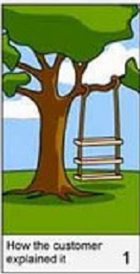
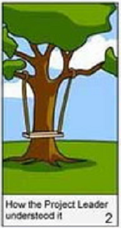
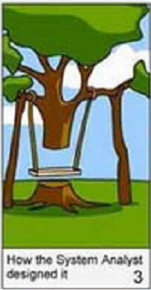
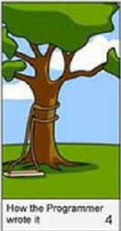
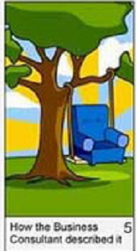
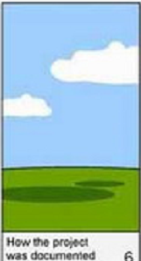
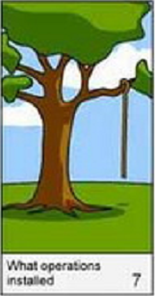
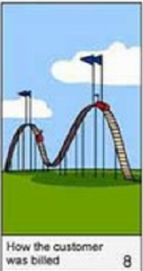
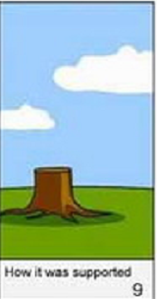
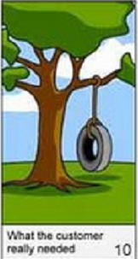
SDLC???

Slide 26
Q & A
Any Question?

